Slide 1
Group 6
Presentation 2

Slide 2
The Brief
2D
Tap input
Turn-based single-device multiplayer
Symmetric level design
Easy to learn game yet hard to master
Notes:
Input is single instant of contact.
Local multiplayer – adversarial. Asynchronous player turns.
Symmetric – players have access to the same knowledge and equal opportunity regarding input effect.

Slide 3
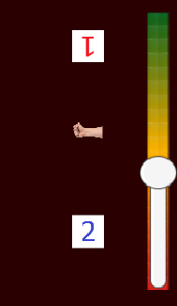
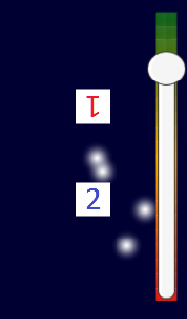
What is our Game?
Timed tap
Asynchronous, turn based
Symmetrical, first turn
Time, tap, progress
Win/loose condition

Slide 4
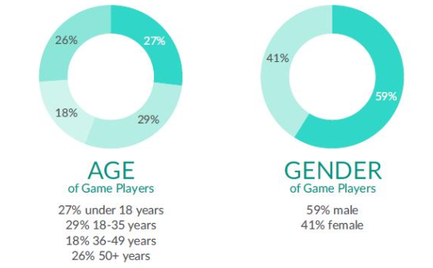
Target Audience
Casual mobile gamers
14 – 35 year old males
Source: https://ukie.org.uk/sites/default/files/UK%20Games%20Industry%20Fact%20Sheet%20February%202018.pdf (pp. 15)

Slide 5
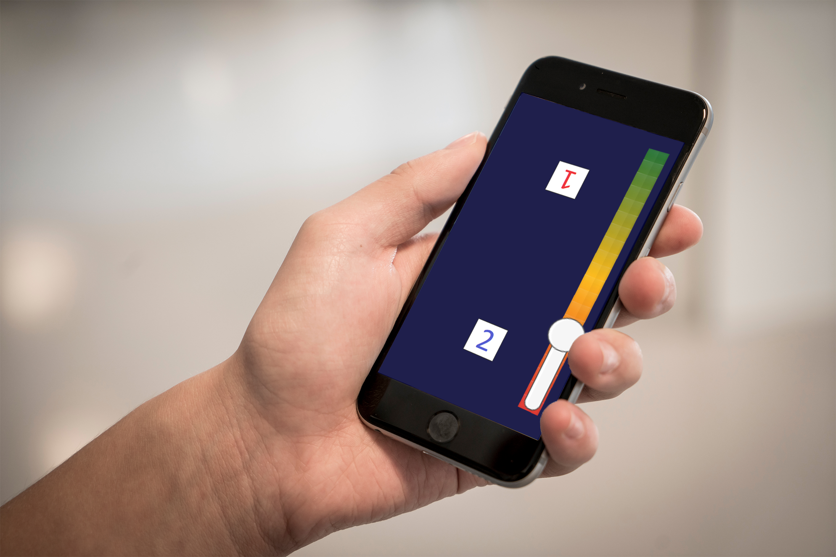
What does the player do?

Slide 6
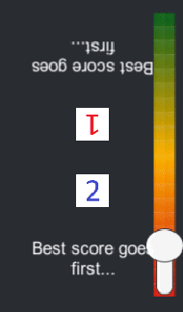
Latest Alpha Build
Most accurate tap wins first turn

Slide 7
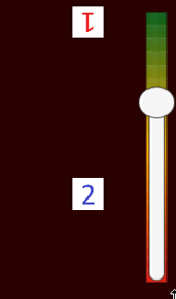
Latest Alpha Build
Timed tap yields greater effect
Win condition

Slide 8
Theme
Why ducks with arms?
Light-hearted and comedic twist
Smashing through first-level consciousness
Natural and intuitive controls

Slide 9

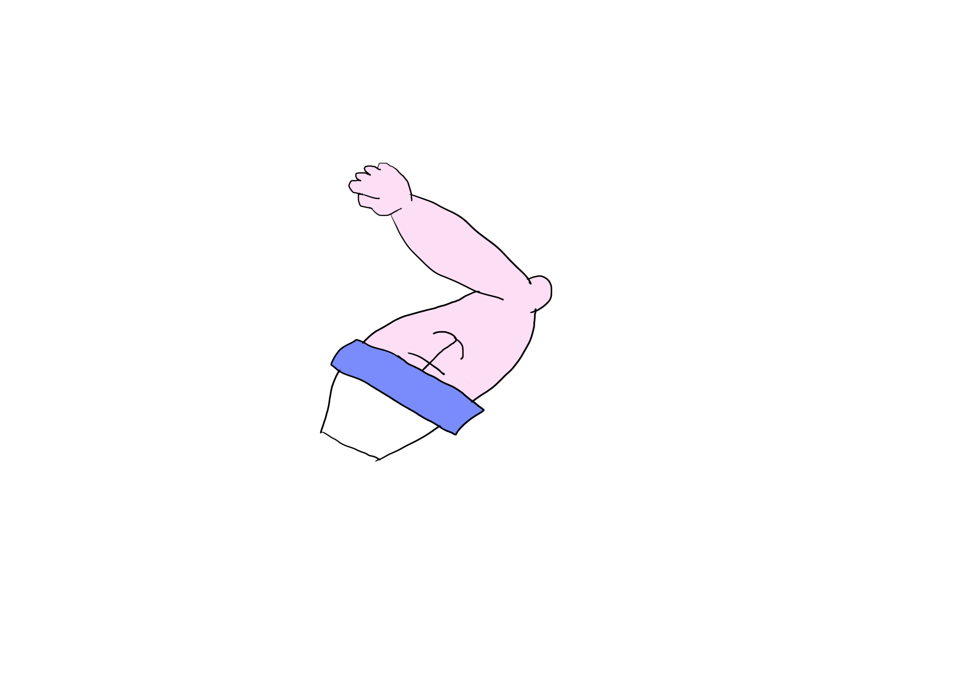
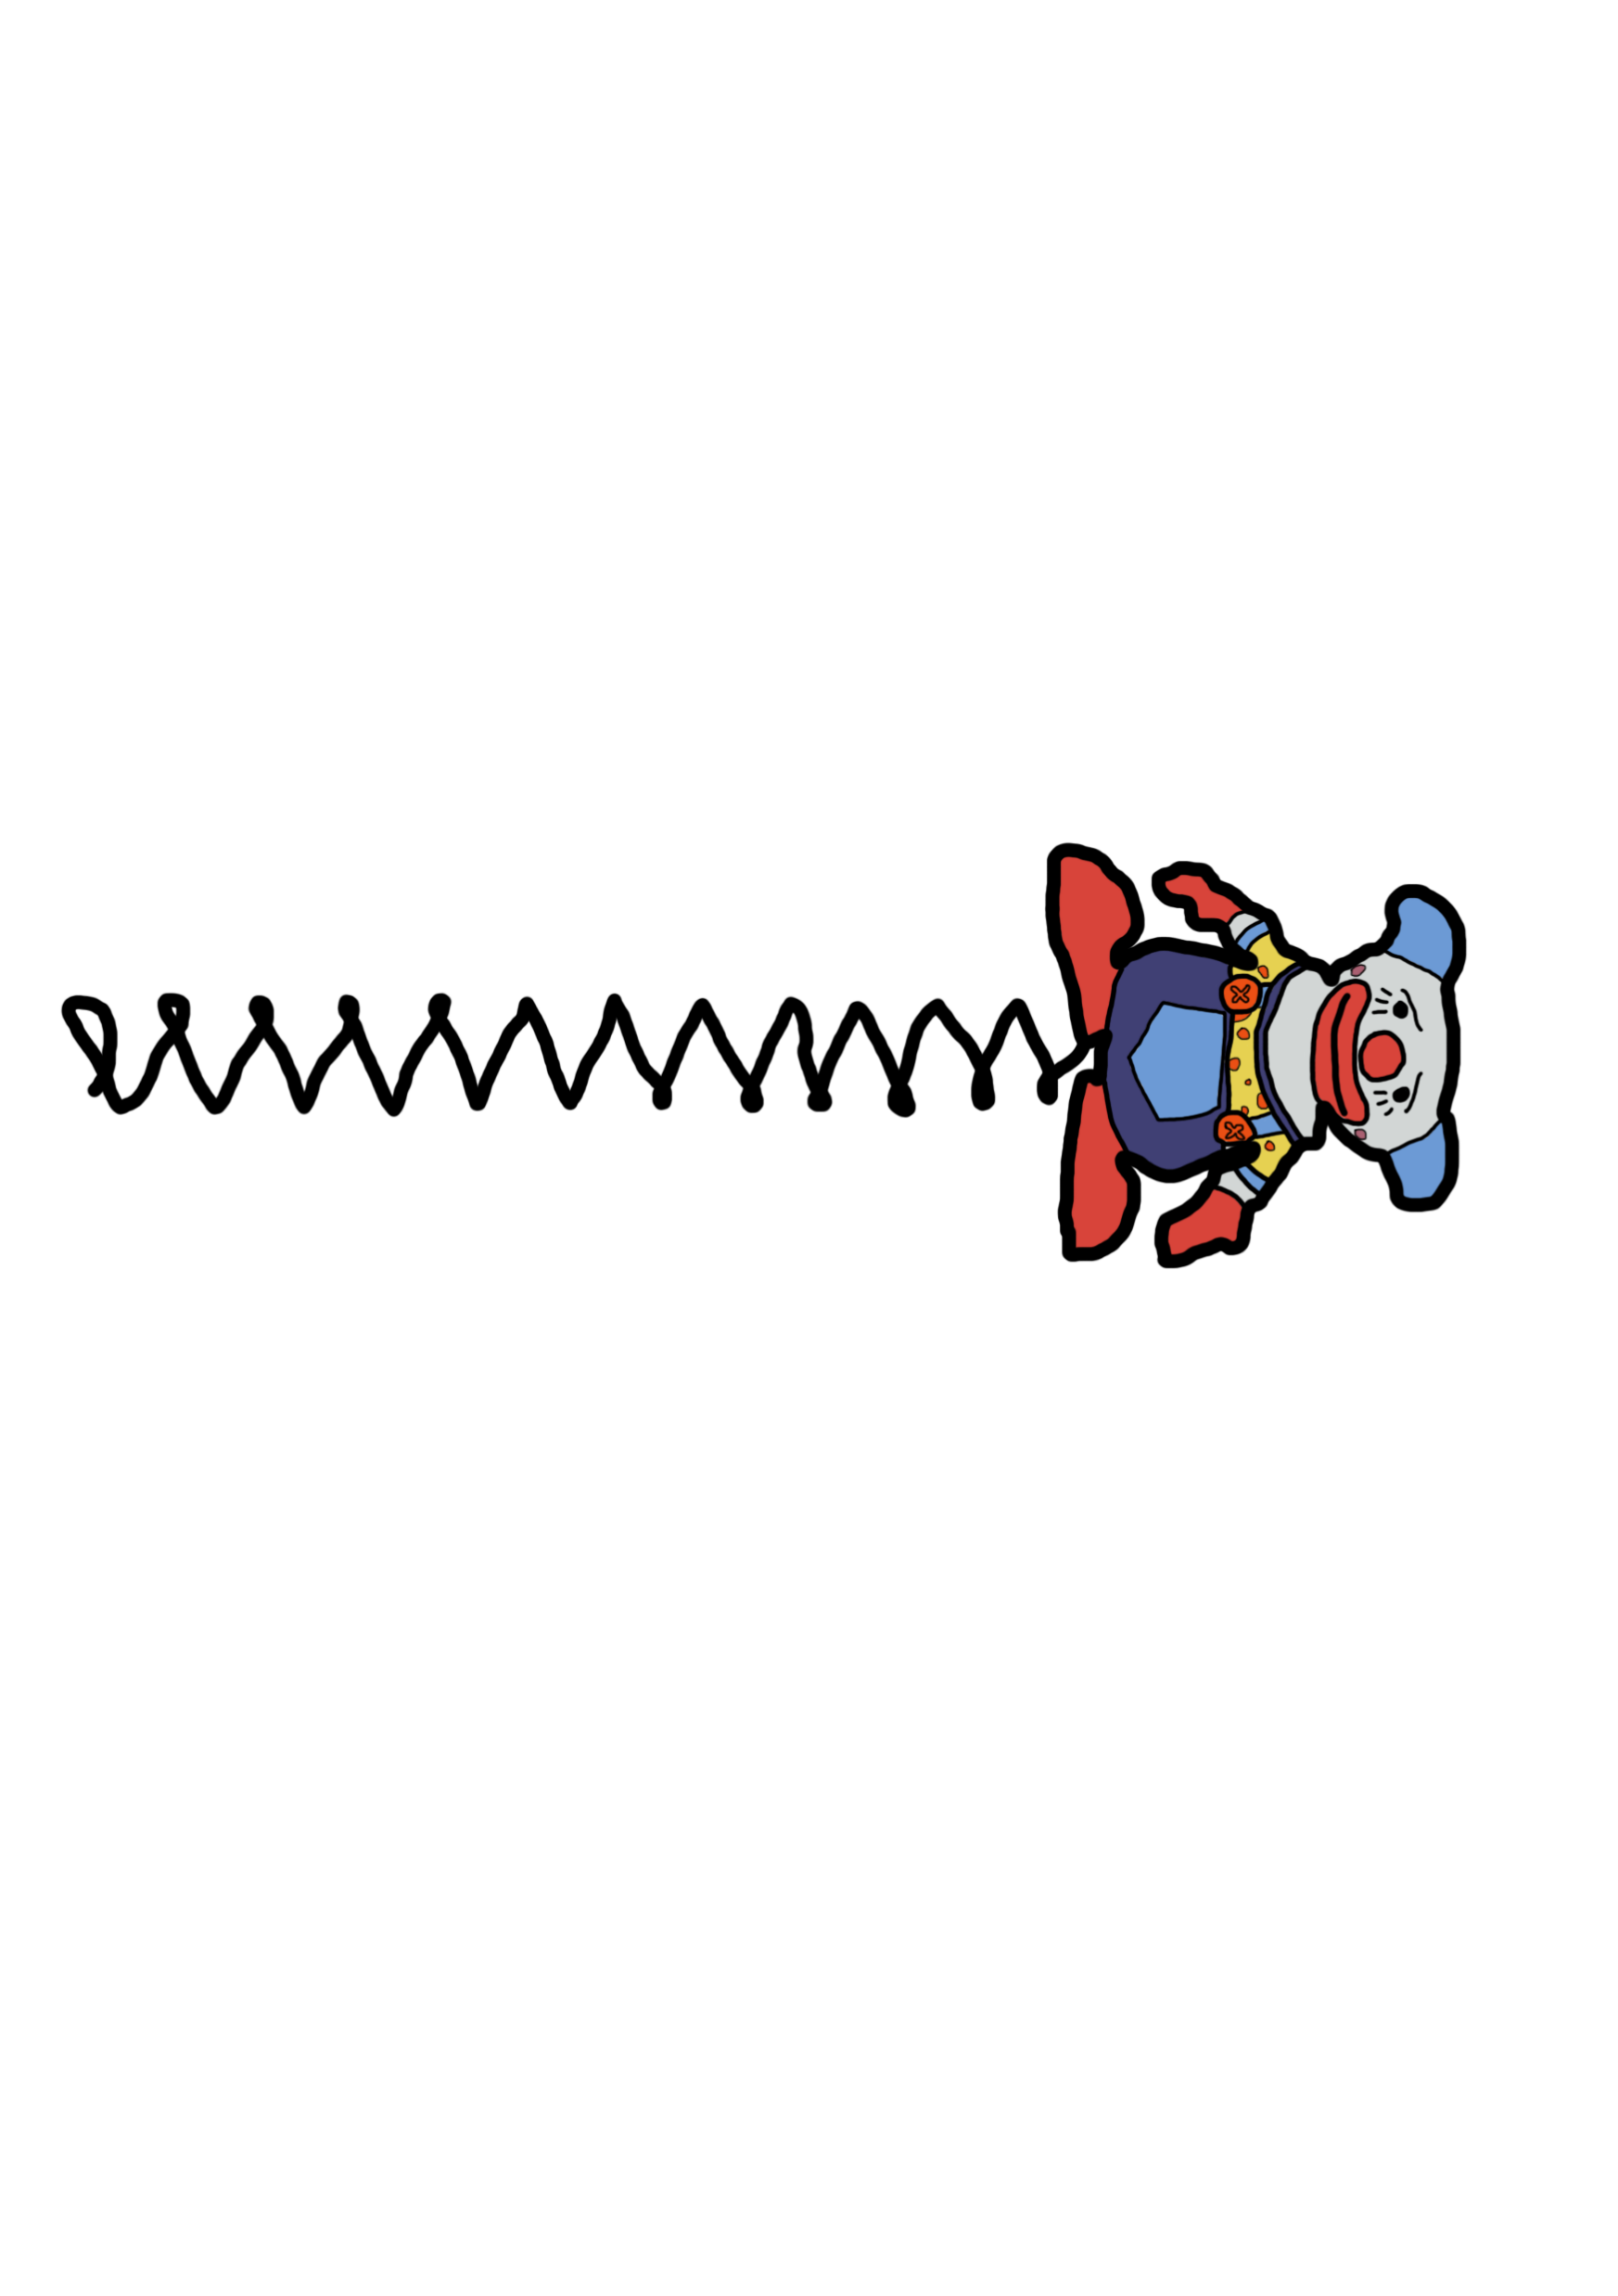
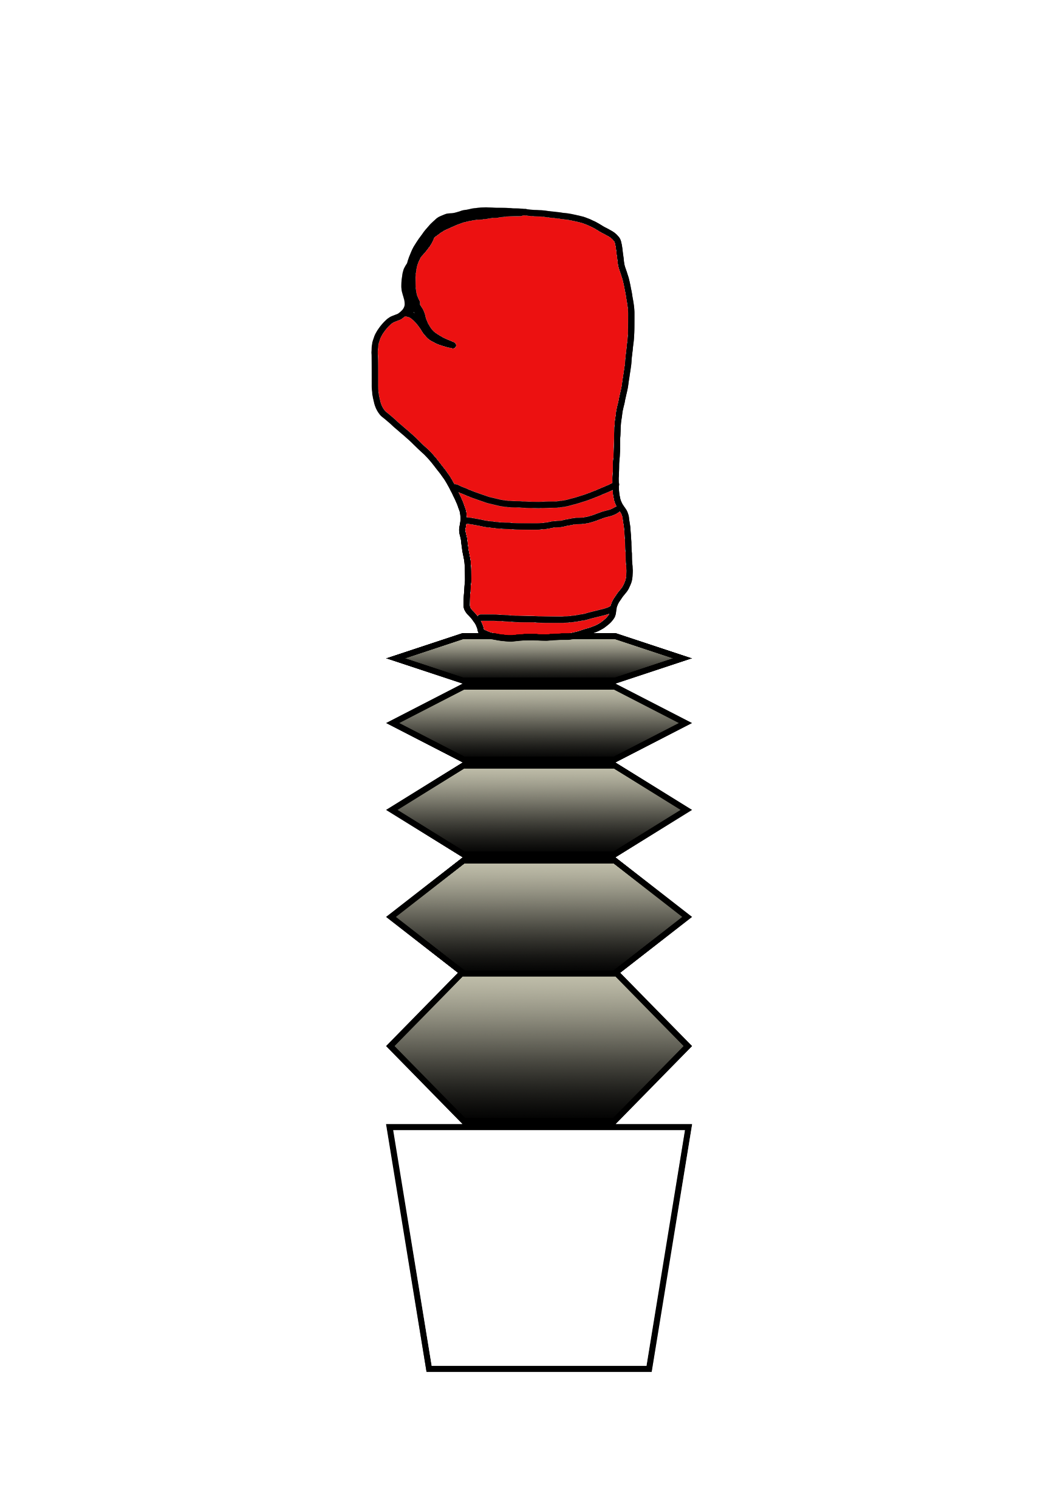


Concept Art

Slide 10
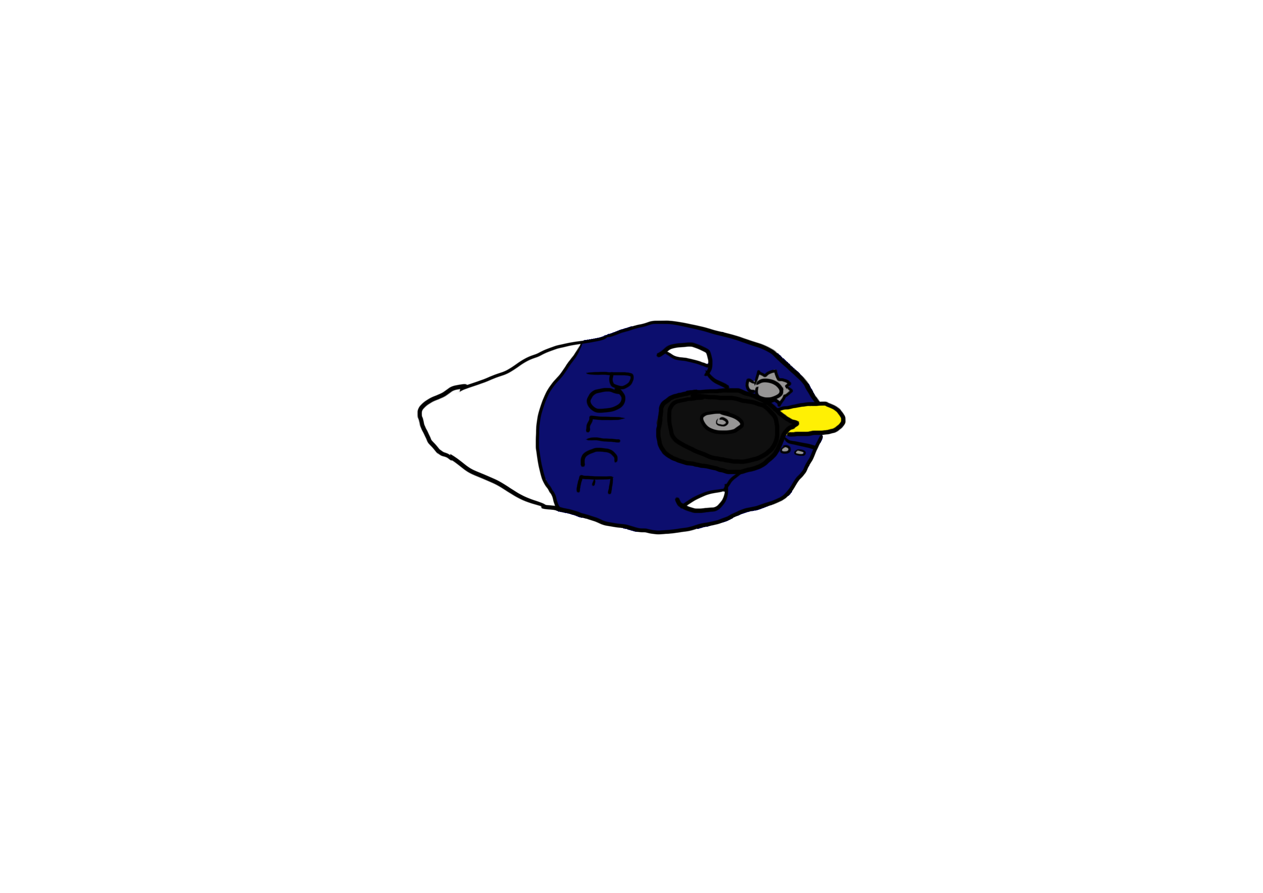
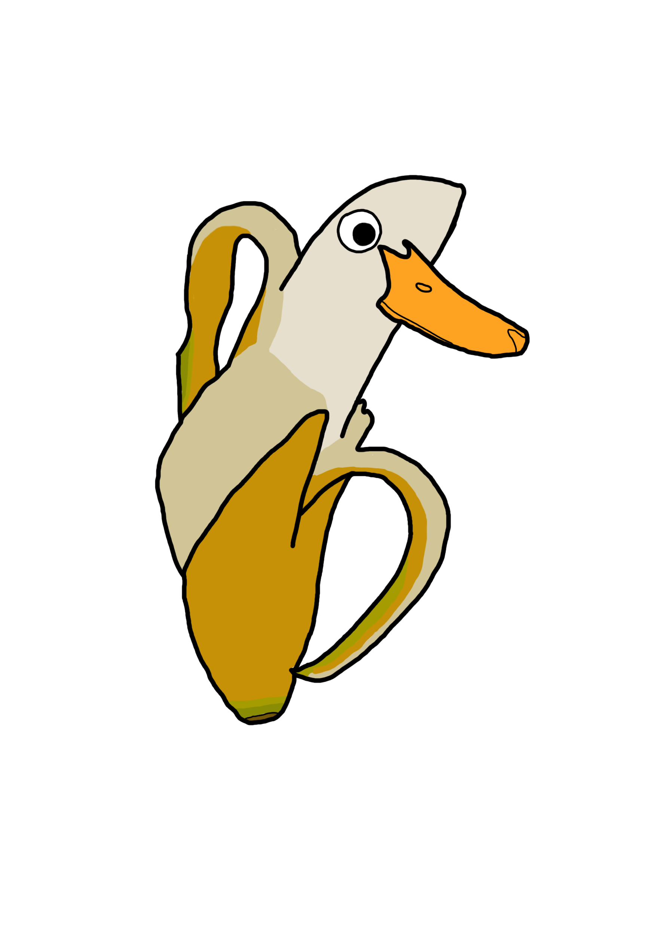
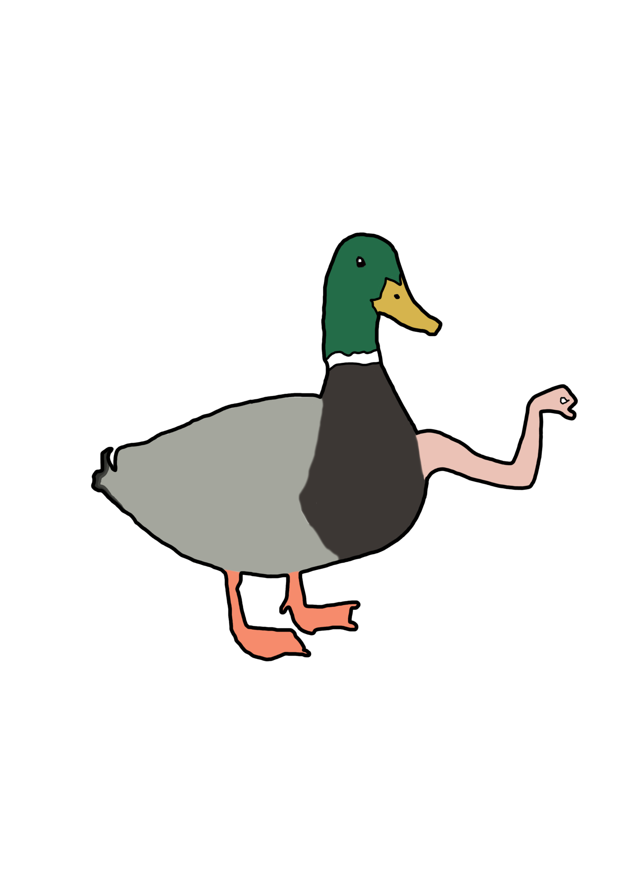

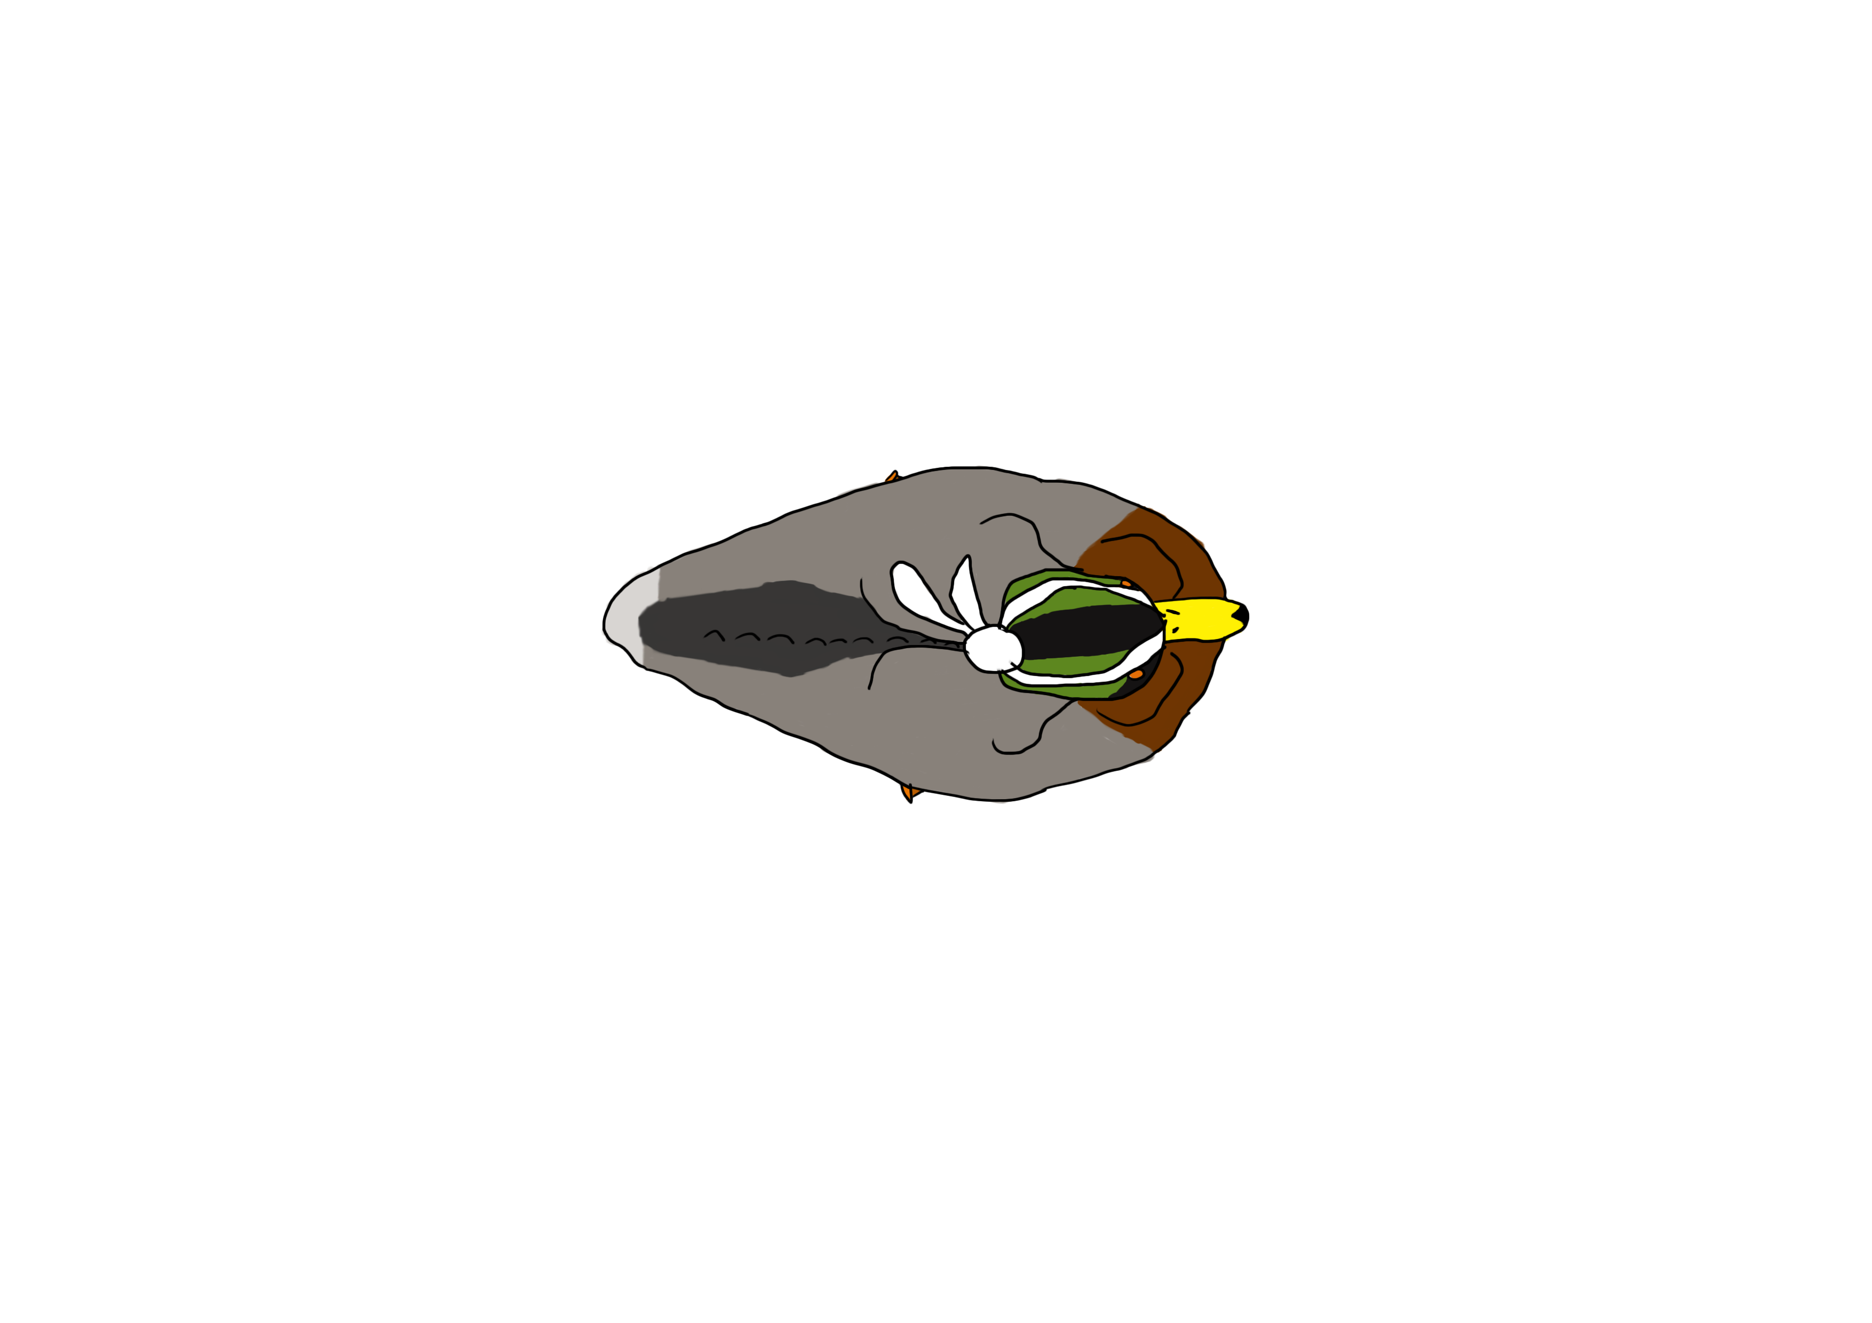

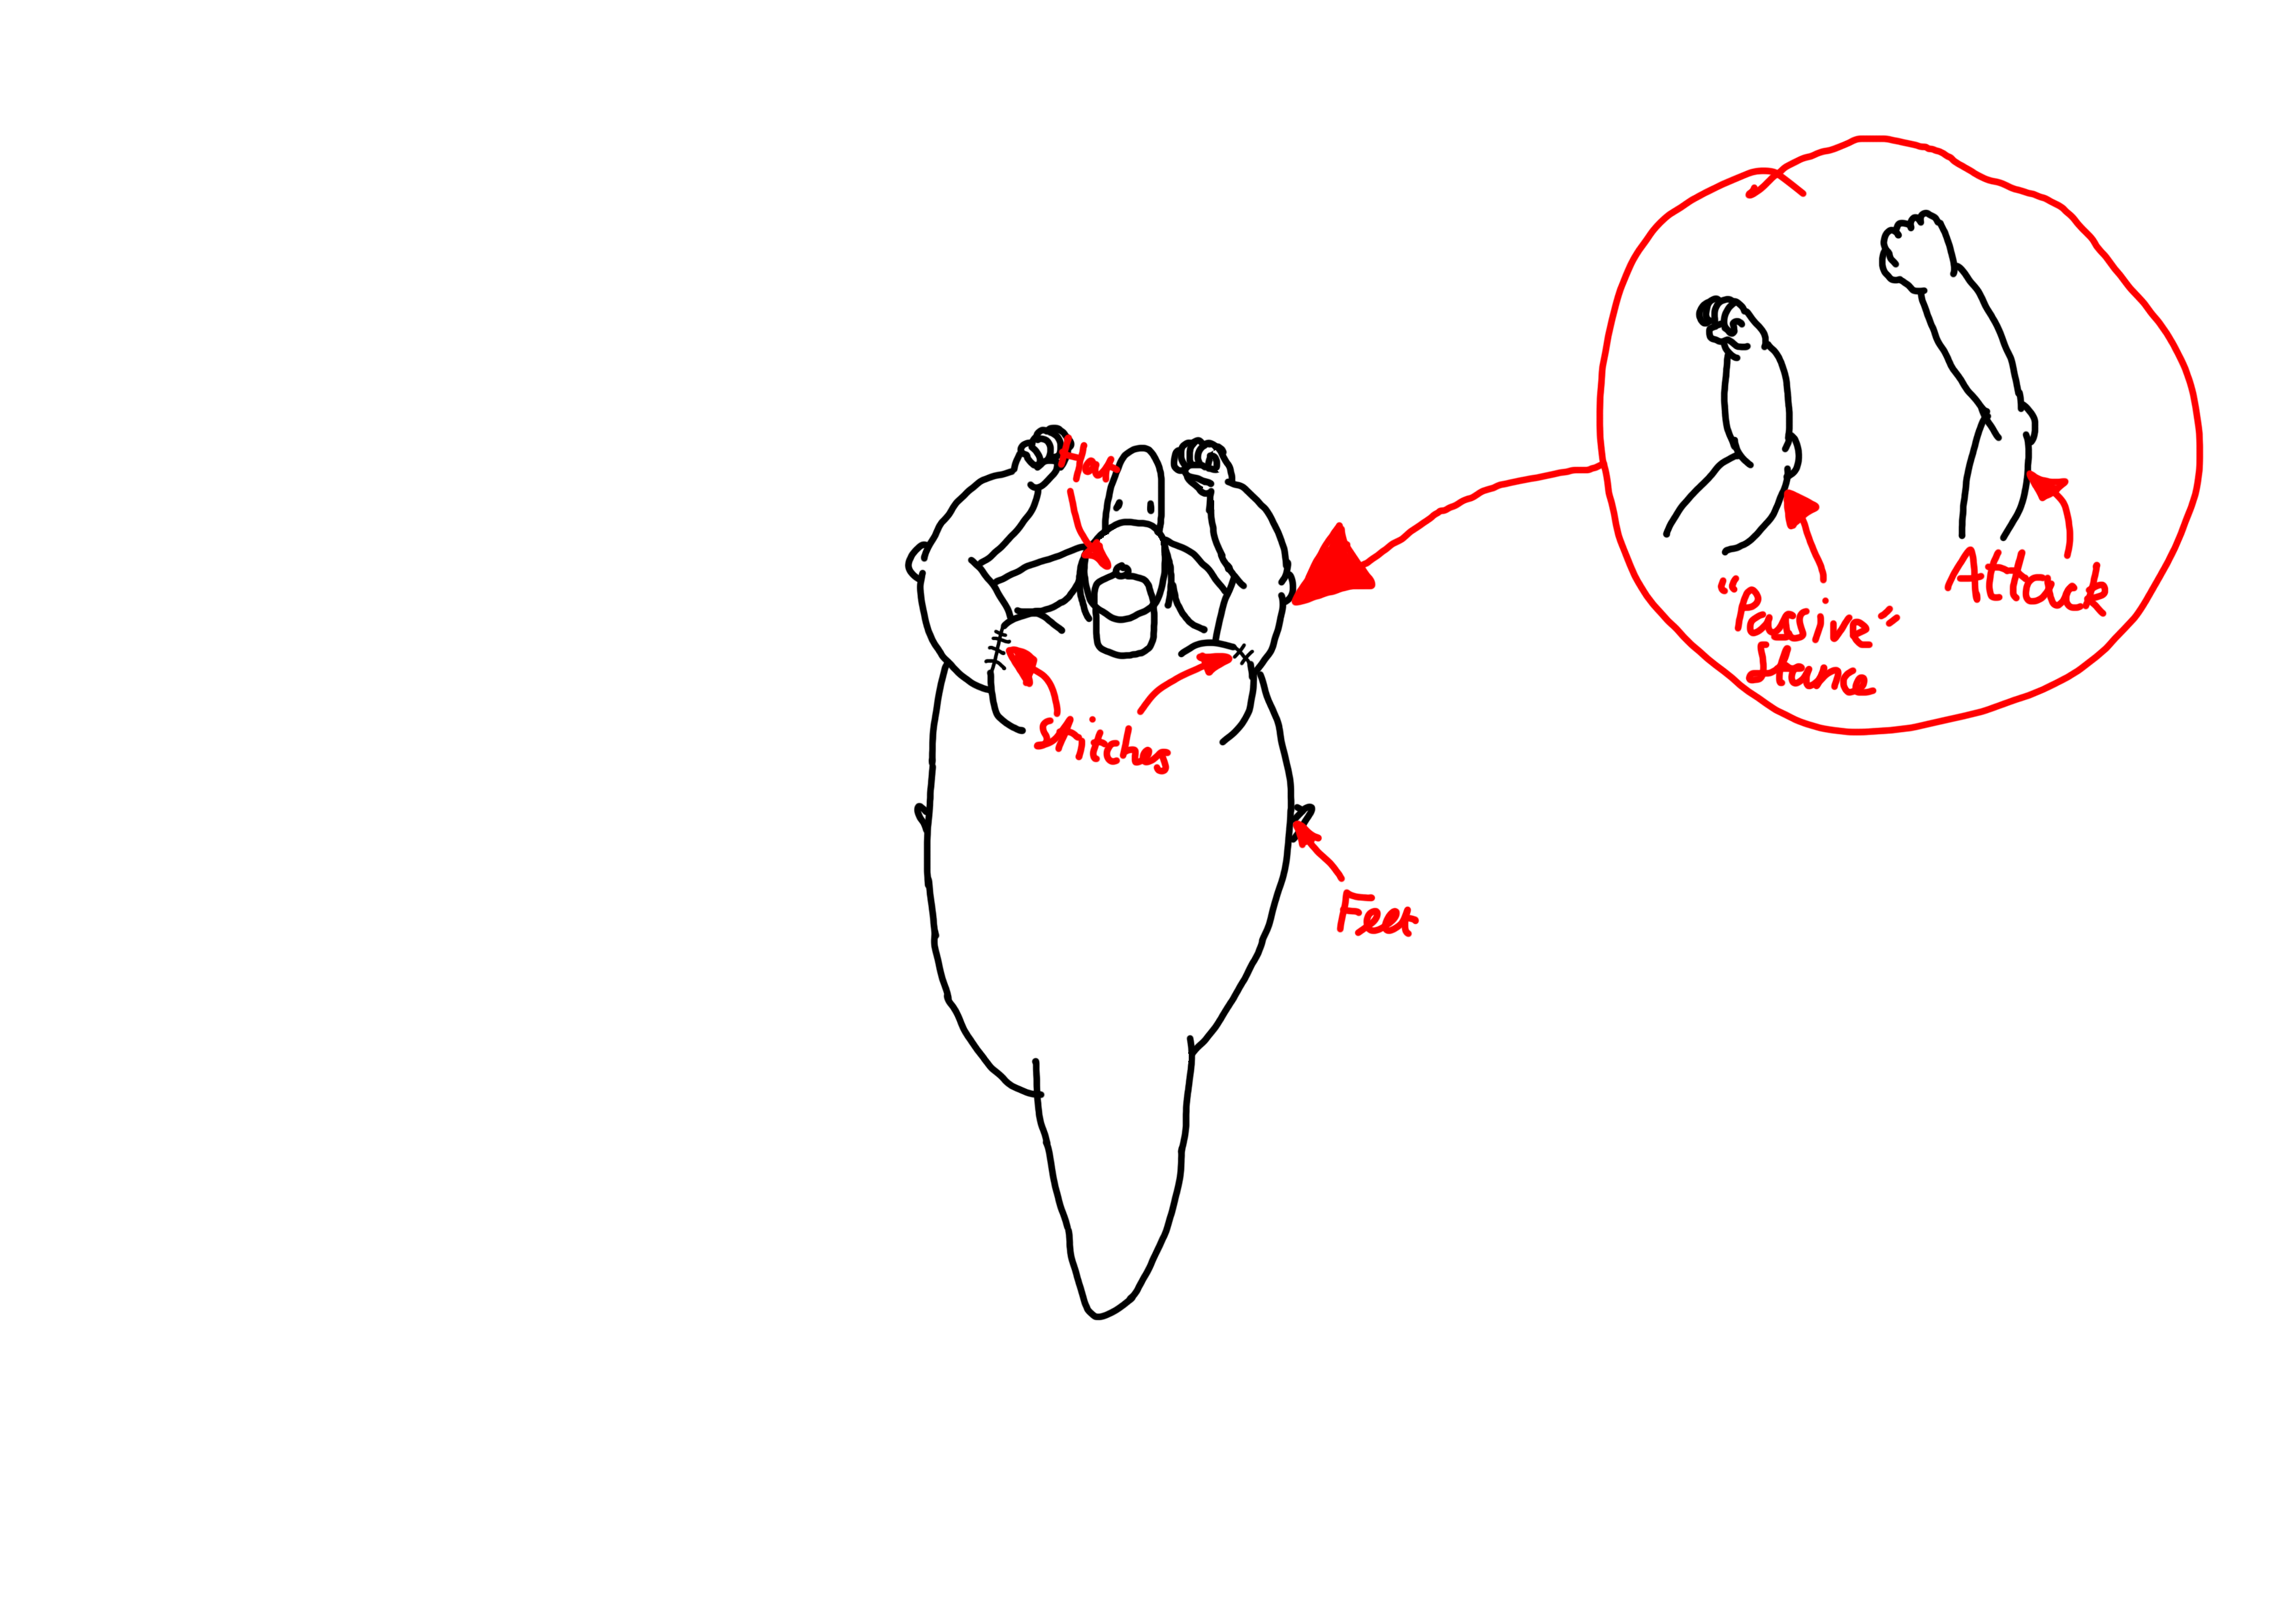

Slide 11
Playtesting and the Iterative Cycle
“Playtesting is the most important part of the game development process” – Mike Ambinder, Senior Experimental Psychologist, Valve

Slide 12
Where’s the fun? – 4 Keys 2 Fun
People fun
Amusement from Competition and Cooperation
Hard fun
Challenge; Fiero from achieving a difficult goal

Slide 13


